Slide 1
Training Presentation
PRAVEEN KUMAR PATEL

Slide 2
Contents
About APV
Domain Overview
ISO
OOP Principles
Abstraction
Encapsulation
Inheritance
Polymorphism
Data types
Access Modifiers
Packages
Exception Handling
Loops
Thread
Collections
Java Swing
Java2D
Junit
Product Overview

Slide 3
APV India Pvt. Ltd.
Established in year 2000.
APV is ISO 9000:2008 certified company that specializes in the design, development, operation, supply, and management of computer software.
The organization has been mainly developing software products used by petroleum industry.
APV is a software company that provides desktop-based and web-based software services to their clients worldwide.
APV is a product based company & supports a full-cycle development process.

Slide 4
Technologies
Expertise in wide variety of technologies :
Platforms: Windows 2003 server, Windows7,XP, and Linux.
Languages: C++, VC++, C#.NET and Java
Web Technologies: ASP.NET, PHP
Databases: SQL Server, MySQL
Internet: HTML, XHTML, XML
Testing: TestComplete, JProfiler, Bugzilla, Jet Brains dot Trace, .Net Memory Profiler

Slide 5

Products
APV
a
b
c
d
e
f
g
h
i

Slide 6
Quality Policy
Consistent Quality and on time delivery that leads to customer’s delight
Leadership through competitive process and professional experience
Continual innovation and improvement
Involvement of people at all levels internally and externally
To move towards CMMI- Level 5

Slide 7
Quality Objectives
Enhancing Customer satisfaction
Improved compliance to planned schedules
Reduce number of errors in the software created
Continual professional development
Increase productivity of the team members developing software

Slide 8
DOMAIN OVERVIEW

Slide 9

Geology
Study of the Earth, the rocks it is composed of , its life forms .
Used to analyze changing behavior of earth.
Helps in predicting the future and past of earth.

Slide 10
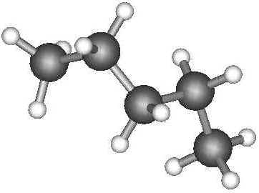
Hydrocarbons
Organic compounds which contain only carbon and hydrogen.
They are the main components of fossil fuels, which include petroleum, coal, and natural gas.
Formation of Hydrocarbons:
Very long & slow natural process .
Formed when dead decaying organic matter in the presence of heat and pressure, results in formation of fossil fuels

Slide 11
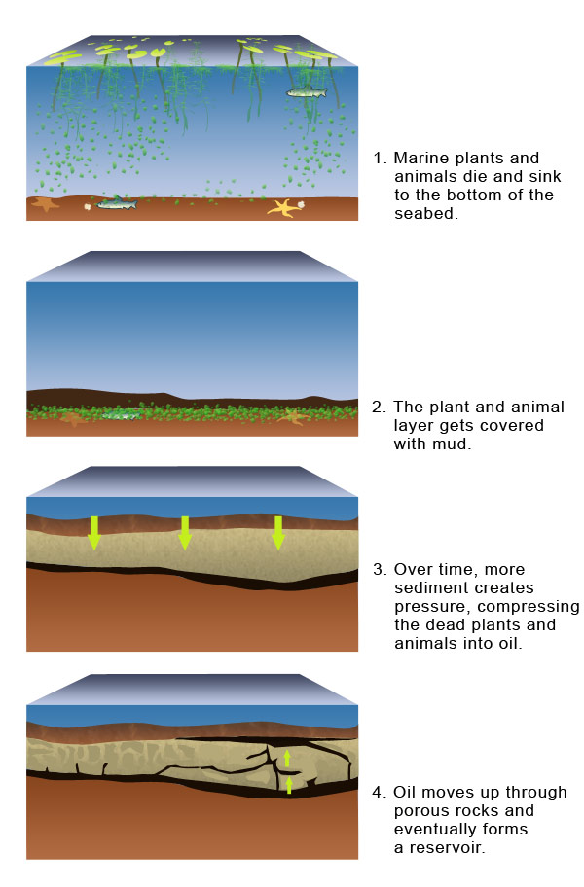

Slide 12

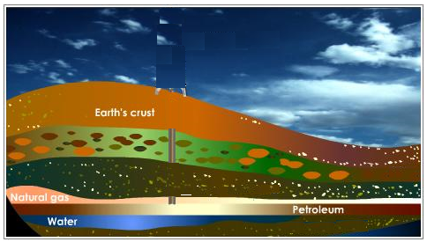
Faults :
A fracture in the Earth along which one
side has moved in relative to the other.
Large faults within the Earth's crust
result from the action of tectonic forces.
The place where temperature and
pressure are optimum for the
generation of oil or gas.
Fault
Kitchen :
Kitchen

Slide 13
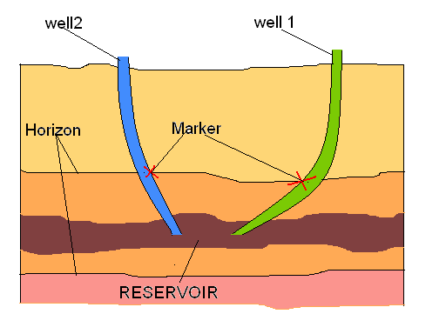
Horizons:
The apparent line that separates one generation of layer with another.
Marker:
When a well is drilled, the point at which the drilled well intersects a horizon is called marker

Slide 14
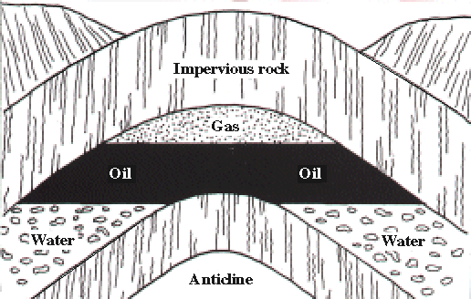
Reservoir :
Subsurface pool of hydrocarbons.
The naturally occurring hydrocarbons, such as crude oil or natural gas, are trapped by overlying rock formations with lower permeability.
Sedimentary rocks are the most common reservoir rocks because of high porosity.
Reservoir

Slide 15
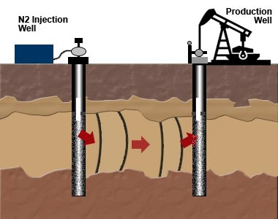
Types of Wells
Producer : produce oil or gas, are drilled once the producing structure and characteristics are determined.
Injector : used for injecting gas or water into the reservoir often as a means to maintain reservoir pressure.
Inactive : dead wells which no longer contain oil or gas.

Slide 16
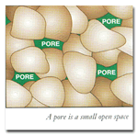
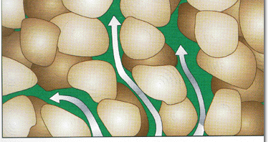
Properties of Rocks
Porosity : Porosity is the ratio of void space in a rock to the total volume of rock, and reflects the fluid storage capacity of the reservoir.
Porosity = Volume of void space
Total volume of rock
Permeability : measure of the ability of a rock or material to transmit fluids. Unit for permeability is the darcy(D), or more commonly the millidarcy (mD).

Slide 17
ISO
Stands for International Organization for Standardization.
Non-Government organization established on 23rd February1947, Headquartered in Geneva
The objective is “to facilitate the international coordination and unification of industrial standards”.

Slide 18
Plan – Do – Check – Act (PDCA)
PDCA cycle is the operating principle of ISO.
Plan – establish objectives and make plans.
Do – implement your plans.
Check – measure/monitor your results.
Act – correct and improve your plans in order to achieve better results .
Plan
Do
Check
Act

Slide 19
Low-Level Languages
Low-level programming languages use simple commands to communicate with the CPU:
Machine language (most basic language of the CPU)
Assembly language (human readable, but close to machine language)

Slide 20
High-Level Languages
High-level languages can be procedural or object-oriented:
Procedural languages use a step-by-step process to solve a problem.
Basic, Pascal
Object-oriented languages model problems using objects that correspond to real-world counterparts.
Smalltalk, C++, Java

Slide 21
What Is Java?
History
Characteristics of Java

Slide 22
Brief history
1990 – suggestion in report „Further” concerning creation of new object oriented environment
1991 – OAK language (James Gosling)
1995 – new language name: “Java”
1996 - Netscape compatible with Java 1.0. Sun propagates Java 1.0 environment

Slide 23
OAK(PROJECT AT SUN)
"Oak" was just a working project name used, supposedly named after an oak tree outside James Gosling's office window. When it was officially released, they didn't want to keep the current project name and chose to switch it to "Java". More---

Slide 24
From OAK to JAVA
From: James Gosling
Date: August 24, 2007 8:16:58 PM PDT
To: Jonathan Schwartz
Subject: How was Java named?
The story goes like this:
We needed a name. We had been using "oak" (which was selected essentially randomly by me), and while the team had grown attached to it, the trademark lawyers ruled it out. We had lots of email debates about names, but nothing got resolved. We ended up in the awkward position where the #1 thing stopping us from shipping was the name.
Our marketing lead knew someone who was a "naming consultant" (I don't remember his name, but he was great). We could neither afford the price nor the time of a conventional product naming process. He agreed to do something rather odd, but effective and quick: he acted as a facilitator at a meeting where about a dozen of us locked ourselves in a room for an afternoon. He started asking us questions like "How does this thing make you feel?" (Excited!) "What else makes you feel that way?" (Java!) We ended up with a board covered with essentially random words. Then he put us through a sorting process where we ended up with a ranking of the names. We ended up with a dozen name candidates and sent them off to the lawyers: they worked down the list until they hit one that cleared their search. "Java" was the fourth name on the list. The first name on the list was "Silk", which I hated but everyone else liked. My favorite was "Lyric", the third one on the list, but it didn't pass the lawyers test. I don't remember what the other candidate names where.
So, who named Java? Marketing organized the meeting, the consultant ran it, and a whole pile of us did a lot of yelling out of random words. I'm honestly not real sure who said "Java" first, but I'm pretty sure it was Mark Opperman.
There certainly wasn't any brilliant marketing mind who went through a coherent thought process.

Slide 25
Java versions
Version | DoB | Code Name | Packages | Classes
JDK 1.0 | 23/01/1996 | Oak | 8 | 212
JDK 1.1 | 19/02/1997 | ------- | 23 | 504
J2SE 1.2 | 08/12/1998 | Playground | 59 | 1520
J2SE 1.3 | 08/05/2000 | Kestrel | 76 | 1842
J2SE1.4 | 06/02/2002 | Merlin | 135 | 2991
J2SE 5.0 | 30/09/2004 | Tiger | 166 | 3279
J2SE 6.0 | 11/12/2006 | Mustang | 203 | 3793
J2SE 7.0 | 28/07/2011 | Dolphin | 209 | 4024

Slide 26
Java Specification(technologies)
Java Micro Edition (J2ME).
J2ME can be used to develop applications for mobile devices such as cell phones.
Java Standard Edition (J2SE)
J2SE can be used to develop client-side standalone applications or applets.
Java Enterprise Edition (J2EE)
J2EE can be used to develop server-side applications such as Java servlets and Java ServerPages.

Slide 27
Java IDE Tools
Forte by Sun MicroSystems
Borland JBuilder
NETBEANS
ECLIPSE

Slide 28
What is Java?
A programming language
Fully buzzword-compliant:
A simple, object oriented, distributed, interpreted, robust, secure, architecture neutral, portable, high performance, multithreaded, dynamic language.
From: Java: An Overview
James Gosling, Sun Microsystems, February 1995.

Slide 29
Object-oriented programming
Object-oriented programming (OOP) is a programming paradigm using "objects" – data structures consisting of data fields and methods together with their interactions – to design applications and computer programs
Programming techniques may include features such as data abstraction, encapsulation, messaging, modularity, polymorphism, and inheritance. Many modern programming languages now support OOP…..
The Simula programming language was the first to introduce the concepts underlying object-oriented programming (objects, classes, subclasses, virtual methods, coroutines, garbage collection and discrete event simulation)… Smalltalk was the first programming language to be called "object-oriented"

Slide 30
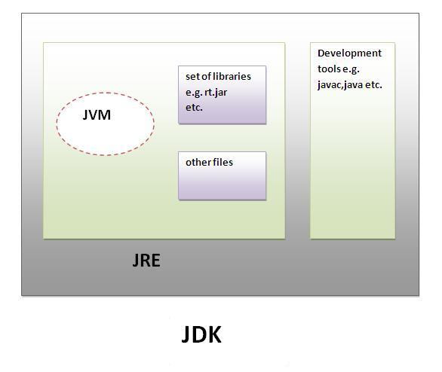
Difference between JDK,JRE and JVM
JDK-JDK is an acronym for Java Development Kit.It physically exists.It contains JRE + development tools.

Slide 31
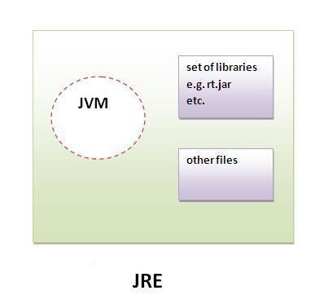
JRE
JRE is an acronym for Java Runtime Environment.It is used to provide runtime environment.
It contains set of libraries + other files that JVM uses at runtime.

Slide 32
JVM
JVM (Java Virtual Machine) is an abstract machine.It is a specification that provides runtime environment in which java bytecode can be executed.
JVMs are available for many hardware and software platforms (i.e.JVM is plateform dependent).
JVM is a specification. Different vendors implement the spec. Eg: Sun (now Oracle), IBM, BEA (now Oracle), all implement the specification and provide their own JVMs. Sun's specific implementation is called Hotspot. BEA's is called JRockit.

Slide 33
Compile and run an application
Write java class Foo containing a main() method and save in file “Foo.java”
The file name MUST be the same as class name
Compile with: javac Foo.java
Creates compiled .class file: Foo.class
Run the program: java Foo

Slide 34
Hello World!
File name: Hello.java
/* Our first Java program – Hello.java */
public class Hello {
//main()
public static void main ( String[] args ) {
System.out.println( "hello world!" );
}
}
Command line arguments
Standard output, print with new line

Slide 35
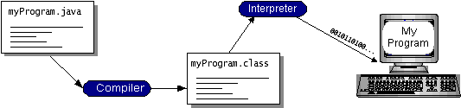
Java – compiled and interpreted

Slide 36
Execution model of Java
compiler
source
(text)
bytecode
(.class file)
virtual machine
verifier
JIT
compiler
bytecode
interpreter
compiled
code
CPU

Slide 37
Just-in-time Compiler
JIT is the part of the Java Virtual Machine (JVM) that is used to speed up the execution time.
JIT compiles parts of the byte code that have similar functionality at the same time, and hence reduces the amount of time needed for compilation. Here the term “compiler” refers to a translator from the instruction set of a Java virtual machine (JVM) to the instruction set of a specific CPU.
Translates bytecode into machine code at runtime
1-time overhead when run initiated
Performance increase approximately 10-30 times
Now the default for most JVM’s
Can be turned off if desired

Slide 38
ByteCode: Food for the VM
Java compilation produces “bytecode”
Intermediate code readable by the VM
Transferable across the Internet as applets
VM interprets BC into instructions
Partly responsible for performance lag
ByteCode produced on any platform may be executed on any other platform which supports a VM

Slide 39
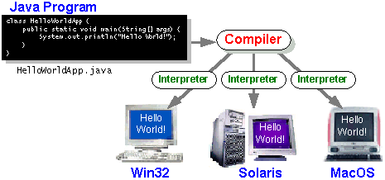
Java – compiled and interpreted

Slide 40
Characteristics of Java
Java is simple
Java is object-oriented
Java is distributed
Java is interpreted
Java is robust
Java is secure
Java is architecture-neutral
Java is portable
Java’s performance
Java is multithreaded

Slide 41
What is class?
Class is defined as the representation of similar type of object.
Once a class is established, you can make as many objects of it as you like, or none.

Slide 42
What is an object?
At runtime, when the Java Virtual Machine (JVM) encounters the new keyword, it will use the appropriate class to make an object which is an instance of that class.
That object will have its own state, and access to all of the behaviors defined by its class.

Slide 43
State (instance variables) Each object (instance of a class) will have its own unique set of instance variables as defined in the class.
Collectively, the values assigned to an object's instance variables make up the object's state.
Behavior (methods) When a programmer creates a class, he creates methods for that class. Methods are where the class' logic is stored.
Methods are where the real work gets done. They are where algorithms get executed, and data gets manipulated.

Slide 44
Class Person: definition
class Person {
String name;
int height; //in inches
int weight; //in pounds
public void printInfo(){
System.out.println(name+" with height="+height+", weight="+weight);
}
}

Slide 45
Class Person: usage
Person ke; //declaration
ke = new Person(); //create an object of Person
ke.name= “Ke Wang”; //access its field
Person sal = new Person();
sal.name=“Salvatore J. Stolfo”;
ke.printInfo();
sal.printInfo();

Slide 46
Class Person
Name: Ke Wang
height: 0
weight: 0
ke
Name: Salvatore J. Stolfo
height: 0
weight: 0
sal

Slide 47
Class Person: variables
Person x;
x=ke;
x.printInfo();
x=sal;
x.printInfo();
This gives the same output as previous code !

Slide 48
Class Person
Name: Ke Wang
height: 0
weight: 0
ke
x
Name: Salvatore J. Stolfo
height: 0
weight: 0
sal
references
objects

Slide 49
References
What do we mean by “references”?
The data stored in a variable is just the “address” of the location where the object is stored
Thus it is separate from the object itself
Ex: If I have a Contacts file on my PC, it will have the address of my friend, John…
I can use that address to send something to Joe or to go visit him if I would like
However, if I change that address in my Contacts file, it does NOT in any way affect Joe, but now I no longer know where Joe is located
However, I can indirectly change the data in the object through the reference
Knowing his address, I can go to Joe’s house and steal his plasma TV

Slide 50
Reference
Person ke;
//only created the reference, not an object. It points to nothing now (null).
ke = new Person();
//create the object (allocate storage in memory), and ke is initialized.
ke.name=“Ke Wang”;
//access the object through the reference

Slide 51
More on reference
Have distinguished value null, meaning pointing to nothing
if( x==null) { … }
Multiple references can point to one object
❑ A reference variable is always of a single, unchangeable type, but it can refer to a subtype object.
❑ A single object can be referred to by reference variables of many different types —as long as they are the same type or a supertype of the object.

Slide 52
Class/interface Access Modifiers
Public:-
A type with public modifier is accessible in any package.
Default:-
A type with no access modifier is accessible in its own package.
(*) Other class modifiers:-
Abstract:-
A class can be declared abstract to restrict its instanciation.
Final:-
If a class is complete , we can use final modifier with it.
Such a class can’t be inherited.

Slide 53
Member Access Modifiers
Public:-
A member with public modifier is accessible in any package.
Protected:-
A member with protected modifier is accessible in its own package.
When its class is inherited , these become the part of the subclass.
Default:-
A type with no access modifier is accessible in its own package.
Private:-
A member with private modifier is accessible only within its class.

Slide 54
Other Member Modifiers
Static:-
Associated with class
Final:-
This modifier can also be applied to local variables.
A final variable in java is blank final i.e. it is need not to be initialized when created, but can be initialized only once.
A final method cannot be overriden.

Slide 55
Abstract:-
A method having no method body is declared abstract.
A class having one or more abstract methods must be declared abstract.
The subclass of such a class must override(define) the abstract methods from its super-class otherwise it also becomes abstract.
We can not use final and private access modifiers.

Slide 56
Local Variables and Access Modifiers
Can access modifiers be applied to local variables? NO!
There is never a case where an access modifier can be applied to a local variable…
You can be certain that any local variable declared with an access modifier willnot compile.
In fact, there is only one modifier that can ever be applied to local variables—final.

Slide 57
Access Modifiers
 | Private | No Modifier | Protected | Public
Same Class | YES | YES | YES | YES
Same Package Subclass | NO | YES | YES | YES
Same Package Non-Subclass | NO | YES | YES | YES
Different Package Subclass | NO | NO | YES | YES
Different Package Non-subclass | NO | NO | NO | YES

Slide 58
Static (Keyword)
These Members are prefixed with keyword ‘static’.
These are associated with class and the class need not be instanced to access these members.
These members are accessible using either class name or object reference.
A static field is created when its class is loaded in memory.
A class is loaded when it is used first time during the execution of a program

Slide 59
class Foo
int size = 42; static void doMore( ){ int x = size; } (ERROR……………………….)
static method cannot
access an instance
(non-static) variable
class Bar
void go ( ); static void doMore( ){ go( ); } (ERROR…………………….)
static method cannot
access a non-static
method
class Baz
static int count; static void woo( ){ } static void doMore( ){ woo( ); int x = count; }
static method
can access a static
method or variable

Slide 60
“new” Operator
The ‘new’ operator is uded to create an object of a class.
Syntax:-
new <ClassName>(<parameters>);
The operator returns the reference of the object that we can store in a reference type variables.

Slide 61
How object is created
class Dog {
int a; // instance variable
Float b;//instance variable
Static c;
public static void main(String [] args) {
Dog d = new Dog();//d is reference variable
d.go();//method calling
}
void go() {
System.out.println(“just demo”);
}}

Slide 62
Object creation in heap
The Heap
Dog object
go()
main() d
c
a
b
Stack
Reference variable

Slide 63
Constructors
These are special member of a class used to construct the initial state of an object.
A constructor has following properties:
Same name as of the class.
No return Type.
Only access modifiers permitted.
Declared in same class .
A default constructor is without formal parameters.
We can declare parameterized constructer , so constructor can be overloaded.
When there is no constructor declared in a class the compiler creates a default constructor with the same accessibility of the class.
Constructors are called when an object is created using new operator.

Slide 64
Can we create object without invoking constructor??
Objects are constructed. we can't make a new object without invoking a constructor.
In fact, we can't make a new object without invoking not just the constructor of the object's actual class type, but also the constructor of each of it superclasses!
Constructors are the code that runs whenever we use the keyword new.

Slide 65
Constructor Chaining
4- Object()
3- Animal() calls super()
2- Horse() calls super()
1- main() calls new Horse()

Slide 66
Class Code (What We Type) | Compiler Generated Constructor Code (in Bold)
class Foo { } | class Foo { Foo() { super(); }
class Foo { Foo() { } } | class Foo { Foo() { super(); } }
public class Foo { } | public class Foo { public Foo() { super(); } }
class Foo { Foo(String s) { } } | class Foo { Foo(String s) { super(); } }

Slide 67
class Foo { Foo(String s) { super(); } } | Nothing, compiler doesn’t need to insert anything.
class Foo { void Foo() { } } | class Foo { void Foo() { } Foo() { super(); } } (void Foo() is a method, not a constructor.)

Slide 68
But what about it???
class Animal {
Animal(String name) { }
}
class Horse extends Animal {
Horse() {
super(); // Problem!
}
}
And once again the compiler treats us with the stunningly lucid:
Horse.java:7: cannot resolve symbol
symbol : constructor Animal ()
location: class Animal
super(); // Problem!

Slide 69
class Foo {
int size;
String name;
Foo(String name, int size) {
this.name = name;
this.size = size;
}
}
In the preceding code example, the Foo class does not have a no-arg constructor.
That means the following will fail to compile:
Foo f = new Foo(); // Won't compile, no matching constructor

Slide 70
But the following will compile:
Foo f = new Foo("Fred", 43); // No problem. Arguments match
// the Foo constructor.

Slide 71
Overloaded Constructors
public class Animal {
String name;
Animal(String name) {
this.name = name;
}
Animal() {
this(makeRandomName());//line no 8
}
static String makeRandomName() {
int x = (int) (Math.random() * 10);
String [] name = {"Fluffy", "Fido","Rover", "Spike","Gigi","a" ,"v","c","d","y"};
return name[x];
}
public static void main (String [] args)
{
Animal a= new Animal();
System.out.println(a.name) ;
}
}

Slide 72
Show’s Constructor Chaining
4- Object()
3- Animal(String s) calls super()
2- Animal() calls this(randomlyChosenNameString)
1- main() calls new Animal()

Slide 73
The key point to get from this code example is in line 8 Rather than calling super(), we're calling this(), and this() always means a call to another constructor in the same class. OK, fine, but what happens after the call to this()?
Sooner or later the super() constructor gets called, right? Yes indeed.
A call to this() just means you're delaying the inevitable.
Some constructor, somewhere,must make the call to super().
Key Rule: The first line in a constructor must be a call to super() or a call to this().

Slide 74
Interface Implementation
❑ Interfaces are contracts for what a class can do, but they say nothing about the way in which the class must do it.
❑ An interface can have only abstract methods, no concrete methods allowed.
❑ Interface methods are by default public and abstract—explicit declaration of these modifiers is optional.
❑ Interfaces can have constants, which are always implicitly public, static, and final.
❑ Interface constant declarations of public, static, and final are optional in any combination.

Slide 75
interface Bounceable
void bounce( ); void setBounceFactor(int b); (WHAT WE DECLARE))
interface Bounceable
public abstract void bounce( ); public abstract void setBounceFactor(int b); (WHAT THE COMPILER SEE)
Class Tire implements Bounceable public void bounce( ){...} public void setBounceFactor(int b){ …}
WHAT THE IMPLEMENTING CLASS MUST DO ??

Slide 76
interface Bounceable
void bounce( ); void setBounceFactor(int bf);
abstract Ball implements Bounceable
/*no methods of Bounceable are implemented in Ball */ void beSpherical( ){}
class BeachBall extends Ball
public void bounce( ){ } public void setBounceFactor (int bf){ } /*beSpherical is not abstract so BeachBall is not required to implement it.*/
abstract Ball implements Bounceable
public void bounce( ){ } public void setBounceFactor (int bf){ }

Slide 77
OOP Principles
OOP
Abstraction
Encapsulation
Inheritance
Polymorphism

Slide 78
Abstraction
Abstraction refers to the act of representing essential features without including the background details or explanations.
Abstraction is a mechanism to reduce complexity.

Slide 79

Encapsulation
The wrapping up of data & functions into a single unit is known as Encapsulation.
Thus keeps data safe from outside interference & misuse.
In Java the basis of encapsulation is the “class”.
For e.g.
class Example{
private memeber1;
private member2;
public void function( ){
//do something;
}
}

Slide 80
Class Person: definition
class Person {
String name;
int height; //in inches
int weight; //in pounds
public void printInfo(){
System.out.println(name+" with height="+height+", weight="+weight);
}
}

Slide 81
Class Person- problem
ke.weight = 150; // too bad, but possible
ke.weight = -20; // Houston, we have a problem!!
Need to ensure the validity of value.
Solution: ask the class to do it!
ke.setWeight(150); // OK, now ke’s weight is 150
ke.setWeight(-10); ******** Error, weight must be positive number

Slide 82
Class Person: add method
class Person{
...
void setWeight(int w){
if(w<=0)
System.out.println("***** error, weight must be positive number! ");
else
weight = w;
}
}

Slide 83
Class Person: new problem
ke.setWeight(-10);
******** Error, weight must be positive number
ke.weight = -20; // changed occurs…………………….
Solution: just make the variable inaccessible from outside!

Slide 84
Class Person: private variable
class Person{
private String name;
private int weight;
private int height;
public void setWeight(int w){
if(w<=0)
System.err.println("***** error, weight must be positive number!");
else
weight = w;
}
}
Keyword private: no one can access the element except itself
Keyword public: everyone can access the element

Slide 85
Class Hello
class Hello{
public static void main ( String[] args ) {
Person ke = new Person();
ke.weight = -20;
}
}
>javac Hello.java
Hello.java:5: weight has private access in Person
ke.weight = -20;
^
1 error

Slide 86
Inheritance
Inheritance is the capability of one class to acquire the properties of another class.
It supports the concept of hierarchical classification.
A class that is inherited is called a superclass & the class that inherits is called subclass.
The keyword “extends” is used for the implementation of inheritance in Java.
For e.g. ,
class Example1 extends Example{
//do something;
}

Slide 87
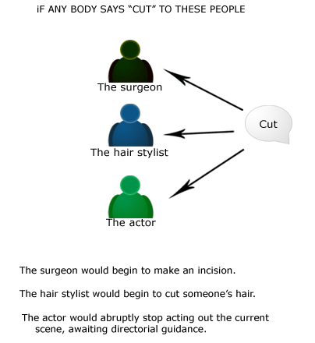
Polymorphism
“ ONE NAME, MULTIPLE FORM”
Polymorphism is a feature that allows one interface to be used for a general class of action.
Through method overloading & overriding polymorphism can be achieved.
Shape
area()
Circle
Rectangle
Triangle
area(circle)
area(rectangle)
area(triangle)

Slide 88
OVERRIDING
Any time we have a class that inherits a method from a superclass, we have the opportunity to override the method (unless the method is marked final).
The key benefit of overriding is the ability to define behavior that's specific to a particular subclass type. The following example demonstrates a Horse subclass of Animal overriding the Animal version of the eat() method:

Slide 89
public class Animal {
public void eat() { }
public void printYourself() {
// Useful printing code goes here
}
}
class Horse extends Animal {
public void printYourself() {
// Take advantage of Animal code, then add some more

Slide 90
WHICH METHOD WILL BE INVOKED AT RUNTIME?????
class Animal {
public void eat() {
System.out.println("Generic Animal Eating Generically");
}
}
class Horse extends Animal {
public void eat() {
System.out.println("Horse eating hay, oats, "+ "and horse treats");
}
public void food() { }
}
public class TestAnimals {
public static void main (String [] args) {
Animal a = new Animal();
Animal b = new Horse(); //Animal ref, but a Horse object
a.eat(); // Runs the Animal version of eat()
b.eat(); // Runs the Horse version of eat()
Animal c = new Horse();
c.food(); // Can't invoke food();
// Animal class doesn't have that method
}
}

Slide 91
Access modifier can not be more restrictive in overriding method……
class Animal {
public void eat() {
System.out.println("Generic Animal Eating Generically");
}
}
class Horse extends Animal {
private void eat() { // ! - it's private!
System.out.println("Horse eating hay "+ "and horse treats");
}
}
public class TestAnimals {
public static void main (String [] args) {
Animal a = new Animal();
Animal b = new Horse(); //Animal ref, but a Horse object
a.eat(); // Runs the Animal version of eat()
b.eat(); // Runs the Horse version of eat()
}
}
If this code compiled (which it doesn't), the following would fail at runtime:
Animal b = new Horse(); // Animal ref, but a Horse // object , so far so good
b.eat(); // Meltdown at runtime!

Slide 92
If a method is overridden but you use a polymorphic (supertype)
reference to refer to the subtype object with the overriding method, the compiler
assumes you’re calling the supertype version of the method. If the supertype version
declares a checked exception, but the overriding subtype method does not, the compiler
still thinks you are calling a method that declares an exception .
Let’s take a look at an example:
class Animal {
public void eat() throws Exception {
// throws an Exception
}
}
class Dog2 extends Animal {
public void eat() { /* no Exceptions */}
public static void main(String [] args) {
Animal a = new Dog2();
Dog2 d = new Dog2();
d.eat(); // ok
a.eat(); // compiler error -
// unreported exception
}
}
This code will not compile because of the Exception declared on the
Animal eat() method. This happens even though, at runtime, the eat() method used
would be the Dog version, which does not declare the exception.

Slide 93
ILLEGAL OVERRIDE

Slide 94
Examples of Legal and Illegal Method Overrides Let's take a look at overriding the eat() method of Animal: public class Animal { public void eat() { } }
Illegal Override Code | Problem with the Code
private void eat() { } | Access modifier is more restrictive
public void eat() throws IOException { } | Declares a checked exception not defined by superclass version
public void eat(String food) { } | A legal overload, not an override, because the argument list changed
public String eat() { } | Not an override because of the return type, not an overload either because there’s no change in the argument list

Slide 95
How method will be invoked at runtime
public class Animal {
public void eat() {
System.out.println("Generic Animal Eating Generically");
}
}
public class Horse extends Animal {
public void eat() {
System.out.println("Horse eating hay ");
}
public void eat(String s) {
System.out.println("Horse eating " + s);
}
}

Slide 96
Method Invocation Code | Result
Animal a = new Animal(); a.eat(); | Generic Animal Eating Generically
Horse h = new Horse(); h.eat(); | Horse eating hay
Animal ah = new Horse(); ah.eat(); | Horse eating hay Polymorphism works—the actual object type (Horse), not the,reference type (Animal), is used to determine which eat() is called.
Horse he = new Horse(); he.eat("Apples"); | Horse eating Apples The overloaded eat(String s) method is invoked.
Animal a2 = new Animal(); a2.eat("treats"); | Compiler error! Compiler sees that Animal class doesn't have an eat() method that takes a String.
Animal ah2 = new Horse(); ah2.eat("Carrots"); | Compiler error! Compiler still looks only at the reference, and sees that Animal doesn’t have an eat() method that takes a String. Compiler doesn’t care that the actual object might be a Horse at runtime.

Slide 97
overloading
class Animal { }
class Horse extends Animal { }
class UseAnimals {
public void doStuff(Animal a) {
System.out.println("In the Animal version");
}
public void doStuff(Horse h) {
System.out.println("In the Horse version");
}
public static void main (String [] args) {
UseAnimals ua = new UseAnimals();
Animal animalObj = new Animal();
Horse horseObj = new Horse();
ua.doStuff(animalObj);
ua.doStuff(horseObj);
}
}
The output is what you expect:
in the Animal version
in the Horse version

Slide 98
But what if you use an Animal reference to a Horse object?
Animal animalRefToHorse = new Horse();
ua.doStuff(animalRefToHorse);
output--- in the Animal version
the reference type (not the object type) determines which overloaded method is invoked!
which overridden version of the method to call is decided at runtime based on object type, but which overloaded version of the method to call is based on the reference type of the argument passed at compile time.

Slide 99
Legal Overloads
public void changeSize(int size, String name, float pattern) { }
The following methods are legal overloads of the changeSize() method:
public void changeSize(int size, String name) { }
public int changeSize(int size, float pattern) { }
public void changeSize(float pattern, String name)
throws IOException { }

Slide 100
CONDITIN | Overloaded Method | RESULT
Argument(s) | Must change. | Must not change.
Return type | Can change. | Can’t change except for covariant returns.
Exceptions | Can change. | Can reduce or eliminate. Must not throw new or broader checkedexceptions.
Access | Can change. | Must not make more restrictive (can be less restrictive).
Invocation | Reference type determines which overloaded version is selected. Happens at compile time. The actual method that’s invoked is still a virtual method invocation that happens at runtime… | Object type determines which method is selected. Happens at runtime.

Slide 101
Packages
Package is a mechanism for organizing a group of related classes & interface in the same directory.
General form of package statement:
package [pkg_name];
To bring certain class or entire package into visibility we use:
import pkgn_name.(classname|*);

Slide 102
Data Types/Return Types
Java is a strongly typed language. This means that every variable must have a declared type.
There are eight primitive types in Java. Four of them are integer types; two are floating-point number types; one is the character type char, and one is a boolean type for truth values.

Slide 103
Primitive types
Primitive type | Size
boolean | 1-bit
char | 16-bit
byte | 8-bit
short | 16-bit
int | 32-bit
long | 64-bit
float | 32-bit
double | 64-bit

Slide 104
Default values for primitive members
When a primitive type data is a member of a class, it’s guaranteed to get a default value even if you don’t initialize it.
Not true for those local variables!!
There will be compile error if you use it without initialization
Primitive type | Default
boolean | false
char | ‘\u0000’ (null)
byte | (byte)0
short | (short)0
int | 0
long | 0L
float | 0.0f
double | 0.0d

Slide 105
When default value assigned??
class Hello{
public static void main ( String[] args ) {
int x;
System.out.println(x);
}
}
>javac Hello.java
Hello.java:5: variable x might not have been initialized
System.out.println(x);
^
1 error

Slide 106
Arrays
In java arrays are objects.
Every array object has a instance field length , that contains the size or array.
Elements of the array are its members.
Elements are accessed with using index starting with zero.
If we use an invalid index, we will get exception.
We can have zero length arrays.
An array is a list of similar things.
An array has a fixed:
name
type
length
These must be declared when the array is created.
Arrays sizes cannot be changed during the execution of the code

Slide 107
Declaring Array Reference
Syntax:
<type> <var> []
<type> [] <var>
Example:
int a[]
float []x

Slide 108
Constructing Variables
Syntax:
(a) new < type> [<Size>]
(b) <var>={<values>}
Example:
int a[]= new int[5];
int b[]= {10,20,30};

Slide 109
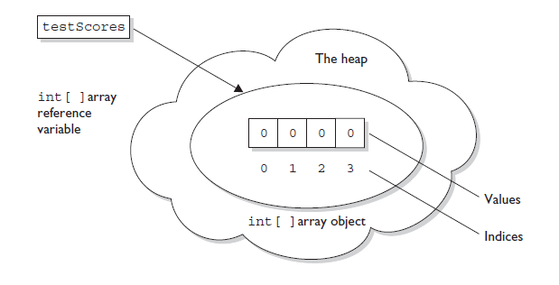
int[] testScores = new int[4];

Slide 110
Definitions Using Array Literals
Used when exact size and initial values of an array are known in advance
used to initialize the array handle
int [] count = { 0,0,0,0} Visualize the results of the above command
count
[0] [1] [2] [3]
0 0 0 0

Slide 111
Definitions Using Array Literals
Consider student names in Section 9.1
Note results:
final String [] STUDENTS = { “john", "Doc" … "Sneezy"};
STUDENTS
[0] [1] [2] [6]
john Doc . . . Sneezy

Slide 112
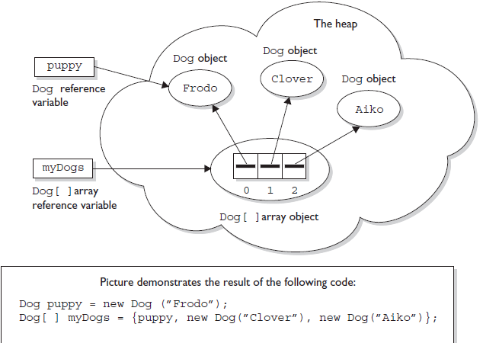
Constructing Multidimensional Arrays

Slide 113
Exceptional Handling
What is Exception?
An exception is a runtime error. It is an indication of a problem that occurs during a program's execution.
Exception handling helps improve a program's fault tolerance.
Java exception handling is managed via five keywords :
try
catch
throw
throws
finally

Slide 114
Types of Exceptions
Two types:
Unchecked exceptions:
Runtime Exceptions
The compiler will not check whether the programmer has handled them or not.
Checked exceptions:
Exceptions except Runtime Exceptions
The compiler will check whether the programmer has handled them or else generate a compilation error.
Exceptions
Unchecked
Checked

Slide 115
Java Exception Hierarchy
Throwable
Exception
Runtime Exception
IO Exception
Error
ArrayIndexOutOfBounds Exception
Arithmetic Exceptions

Slide 116
HANDLING EXCEPTION USING TRY,CATCH AND FINALLY?????????

Slide 117
1: try {
2: // This is the first line of the "guarded region".
//…………………………………………………
//……………………………………………..
3: }
4: catch(MyFirstException) {
5: // Put code here that handles this exception
6: }
7: catch(MySecondException) {
8: // Put code here that handles this exception
9: }
10: finally {
11: // Put code here to release any resource we
12: // allocated in the try clause.
13: }
14:
15: // More code here

Slide 118
The following legal code demonstrates a try with a finally but no catch:
try {
// do stuff
} finally {
//clean up
}
The following legal code demonstrates a try, catch, and finally:
try {
// do stuff
} catch (SomeException ex) {
// do exception handling
} finally {
// clean up
}

Slide 119
The following ILLEGAL code demonstrates a try without a catch or finally:
try {
// do stuff
}
// need a catch or finally here
System.out.println("out of try block");
The following ILLEGAL code demonstrates a misplaced catch block:
try {
// do stuff
}
// can't have code between try/catch
System.out.println("out of try block");
catch(Exception ex) { }

Slide 120
Propagating Uncaught Exceptions
Why aren't catch clauses required? What happens to an exception that's thrown in a try block when there is no catch clause waiting for it?
Actually, there's no requirement that you code a catch clause for every possible exception that could be thrown from the corresponding try block.
In fact, it's doubtful that you could accomplish such a feat! If a method doesn't provide a catch clause for a particular exception, that method is said to be "ducking" the exception (or "passing the buck").

Slide 121
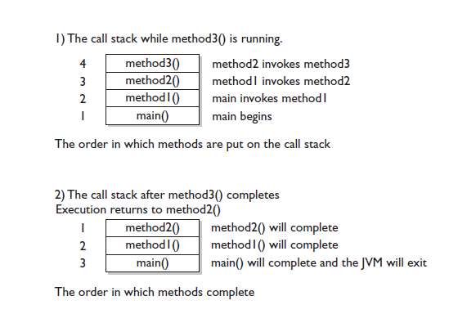
The Java method call stack

Slide 122
The following code throws an exception,
class TestEx {
public static void main (String [] args) {
doStuff();
}
static void doStuff() {
doMoreStuff();
}
static void doMoreStuff() {
int x = 5/0; // Can't divide by zero!
// ArithmeticException is thrown here
}
}
which prints out a stack trace something like,
%java TestEx
Exception in thread "main" java.lang.ArithmeticException: /
by zero
at TestEx.doMoreStuff(TestEx.java:10)
at TestEx.doStuff(TestEx.java:7)
at TestEx.main(TestEx.java:3)

Slide 123
Exception Matching
try {
// do risky IO things
} catch (IOException e) {
// handle general IOExceptions
} catch (FileNotFoundException ex) {
// handle just FileNotFoundException
}
You'll get a compiler error something like this:
TestEx.java:15: exception java.io.FileNotFoundException has
already been caught
} catch (FileNotFoundException ex) {

Slide 124
Garbage Collection in Java

Slide 125
What is a JVM?
The Java Virtual Machine has 2 primary jobs:
Execute Code
Manage Memory
It also does stuff like managing locks

Slide 126
What is Garbage Anyhow?
“An object is created in the heap and is garbage-collected after there are no more references to it. Objects cannot be reclaimed or freed by explicit language directives.”
Objects become garbage when there are no more references to the object

Slide 127
GC History
Garbage Collection (GC) has been around for a while (1960’s LISP, Smalltalk, Eiffel, Haskell, ML, Scheme and Modula-3)
Went mainstream in the 1990’s with Java (then C#)
JVM implementations have improved on GC algorithms/speed over the past decade

Slide 128
GC Benefits
Benefits
Increased reliability
Decoupling of memory mgmt from program design
Less time spent debugging memory errors
memory leaks do not occur (Note: Java programs do NOT have memory leaks………)

Slide 129
Reachability
Roots – reference to object in a static variable or local variable on an active stack frame
Root Objects – directly reachable from roots
Live Objects – all objects transitively reachable from roots
Garbage Objects – all other objects

Slide 130
Reachability Example
Runtime
Stack
Heap
ref
ref
x
x
x

Slide 131
GC Algorithms
Two basic approaches:
Reference Counting – keep a count of references to an object; when a count of zero, object is garbage
Tracing – trace out the graph of objects starting from roots and mark; when complete, unmarked objects are garbage

Slide 132
Reference Counting
An early GC strategy
Disadvantages:
does not detect cycles
overhead in incrementing/decrementing counters
Reference Counting is currently out-of favor….

Slide 133
Tracing
Basic tracing algorithm is known as mark and sweep
mark phase – GC traverses reference tree, marking objects
sweep phase – umarked objects are finalized/freed
Notes:
Tracing collector stops the world (although no necessarily for the entire duration of the collection) and start tracing objects, starting at the root set and following references until all reachable objects have been examined.

Slide 134
Mark-Sweep Example
1. mark-sweep start
x
Root
x
x
x
x
2. end of marking
x
aRoot
x
a
x
x
a
a
x
3. end of sweeping
Root

Slide 135
Mark-Sweep
Problem is fragmentation of memory
Two strategies include:
Mark-Compact Collector – After mark, moves live objects to a contiguous area in the heap
Copy Collector – moves live objects to a new area

Slide 136
Mark-Compact Collector Example
1. end of marking
x
aRoot
x
a
x
x
a
a
x
2. end of compacting
Root

Slide 137
Copy Collector Example
1. copying start
From
x
Root
x
x
x
x
To
Unused
2. end of copying
Unused
To
From
Root

Slide 138
Performance Characteristics
Mark-Compact collection time is roughly proportional to the size of the heap
Copy collection time is roughly proportional to the number of live objects

Slide 139
Copying
Advantages:
Very fast…if live object count is low
No fragmentation
Disadvantages:
Doubles space requirements – not practical for large heaps

Slide 140
USING FINALIZE METHOD
The following program lets us know how much total memory the JVM has available to it and how much free memory it has. It then creates 10,000 Date objects.
After this, it tells us how much memory is left and then calls the garbage collector …..
The final free memory result should indicate whether it has run. Let's look at the program:

Slide 141
1. import java.util.Date;
2. public class CheckGC {
3. public static void main(String [] args) {
4. Runtime rt = Runtime.getRuntime();
5. System.out.println("Total JVM memory: "
+ rt.totalMemory());
6. System.out.println("Before Memory = "
+ rt.freeMemory());
7. Date d = null;
8. for(int i = 0;i<10000;i++) {
9. d = new Date();
10. d = null;
11. }
12. System.out.println("After Memory = "
+ rt.freeMemory());
13. rt.gc(); // an alternate to System.gc()
14. System.out.println("After GC Memory = "
+ rt.freeMemory());
15. }
16. }
Now, let's run the program and check the results:
Total JVM memory: 1048568
Before Memory = 703008
After Memory = 458048
After GC Memory = 818272

Slide 142
Tricky Little finalize() Gotcha's
There are a couple of concepts concerning finalize() that you need to remember.
■ For any given object, finalize() will be called only once (at most) by the
garbage collector.
■ Calling finalize() can actually result in saving an object from deletion.
Let's look into these statements a little further. First of all, remember that any
code that you can put into a normal method you can put into finalize(). For
example, in the finalize() method we could write code that passes a reference
to the object in question back to another object, effectively uneligiblizing the object for garbage collection. If at some point later on this same object becomes eligible for garbage collection again, the garbage collector can still process this object and delete it. The garbage collector, however, will remember that, for this object, finalize() already ran, and it will not run finalize() again.

Slide 143
Loops
A loop allows the programmer to specify that a program should repeat an action while some condition remains true.
Java loops come in three flavors:
while
do-while
for
The for loop has two variations:
for
for-each

Slide 144
While Loop
The while loop is good for scenarios where you don't know how many times a block or statement should repeat, but you want to continue looping as long as some condition is true.
A while statement looks like this:
while (expression) {
// do stuff
}
No
Yes
condition
Loop body

Slide 145
do-while Loop
The do...while repetition statement is similar to the while statement , except that the expression is not evaluated until the do loop's code is executed.
Therefore the code in a do loop is guaranteed to execute at least once.
The following shows a do loop :
do {
// do stuff
} while(condition); No Yes
process
condition

Slide 146
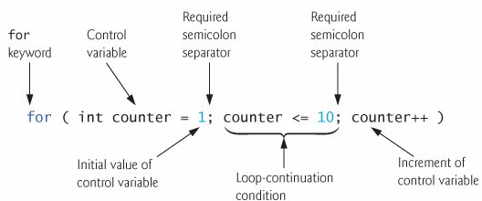
For Loop
The for loop is especially useful for flow control when you already know how many times you need to execute the statements in the loop's block.
The for loop declaration has three main parts, besides the body of the loop:
Declaration and initialization of variables
The boolean expression (conditional test)
The iteration expression

Slide 147
For-each Loop
It is a specialized for loop that simplifies looping through an array or a collection.
Also known as : “for-in “ and "enhanced for" loop.
For-each is declared as:
for(declaration : expression)
Difference between basic for & enhanced for loop:
int [] a = {1,2,3,4};
for(int x = 0; x < a.length; x++) // basic for loop System.out.print(a[x]);
for(int n : a) // enhanced for loop System.out.print(n);

Slide 148
The String Class

Slide 149
String class facts
An object of the String class represents a string of characters…
The String class belongs to the java.lang package .
Like other classes, String has constructors and methods…
Unlike other classes, String has two operators, + and += (used for concatenation)…

Slide 150
Literal Strings
are defined by enclosing text in double quotes. “This is a literal String”…..
don’t have to be constructed….
can be assigned to String variables…..
can be passed to methods and constructors as parameters…..

Slide 151
Literal String examples
//assign a literal to a String variable
String name = “Robert”;
//calling a method on a literal String
char firstInitial = “Robert”.charAt(0);
//calling a method on a String variable
char firstInitial = name.charAt(0);

Slide 152
Immutability
Once created, a string cannot be changed: none of its methods changes the string.
Such objects are called immutable.
Immutable objects are convenient because several references can point to the same object safely: there is no danger of changing an object through one reference without the others being aware of the change.

Slide 153
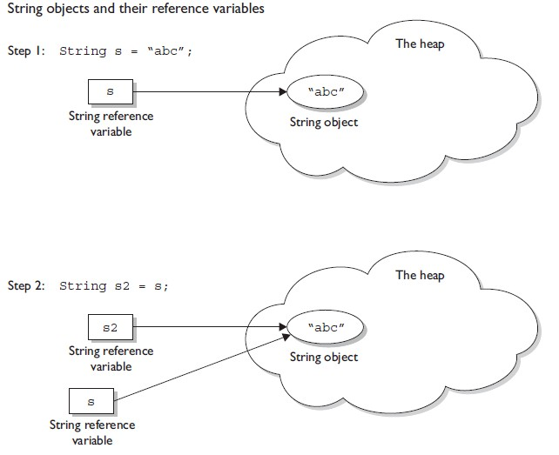

Slide 154
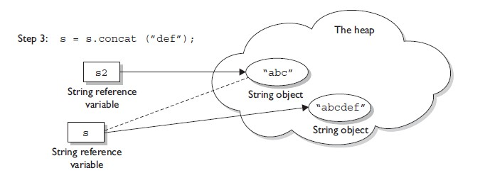

Slide 155
Advantages Of Immutability
Uses less memory.
String word1 = "Java";
String word2 = word1;
String word1 = “Java";
String word2 = new String(word1);
word1
word1
“Java"
“Java"
word2
“Java"
word2
Less efficient: wastes memory
OK

Slide 156
Disadvantages of Immutability
Less efficient — you need to create a new string and throw away the old one even for small changes.
String word = “Java";
char ch = Character.toUpperCase(word.charAt (0));
word = ch + word.substring (1);
word
“java"
“Java"

Slide 157
Empty Strings
An empty String has no characters. It’s length is 0.
String word1 = "";
String word2 = new String();
Empty strings

Slide 158
No Argument Constructors
No-argument constructor creates an empty String. Rarely used.
A more common approach is to reassign the variable to an empty literal String.
String empty = new String();
String empty = “”;//nothing between quotes

Slide 159
Copy Constructors
Copy constructor creates a copy of an existing String. Also rarely used.
Not the same as an assignment.
Copy Constructor: Each variable points to a different copy of the String.
String word = new String(“Java”); String word2 = new String(word);
word
“Java"
word2
“Java"
Assignment: Both variables point to the same String.
String word = “Java”; String word2 = word;
word
“Java"
word2

Slide 160
Other Constructors
Most other constructors take an array as a parameter to create a String.
char[] letters = {‘J’, ‘a’, ‘v’, ‘a’}; String word = new String(letters);//”Java”

Slide 161
Methods — length, charAt
int length();
char charAt(i);
Returns the number of characters in the string
Returns the char at position i.
Character positions in strings are numbered starting from 0 – just like arrays.
Returns:
”Problem".length();
”Window".charAt (2);
7
’n'

Slide 162
Methods — substring
Returns a new String by copying characters from an existing String.
String subs = word.substring (i, k);
returns the substring of chars in positions from i to k-1
String subs = word.substring (i);
returns the substring from the i-th char to the end
television
i k
television
i
Returns:
”television".substring (2,5);
“immutable".substring (2);
“bob".substring (9);
“lev"
“mutable"
"" (empty string)

Slide 163
Methods — Concatenation
String word1 = “re”, word2 = “think”; word3 = “ing”;
int num = 2;
String result = word1 + word2;
//concatenates word1 and word2 “rethink“
String result = word1.concat (word2);
//the same as word1 + word2 “rethink“
result += word3;
//concatenates word3 to result “rethinking”
result += num; //converts num to String //and concatenates it to result “rethinking2”

Slide 164
Methods — Find (indexOf)
0 2 6 10 15
String name =“President George Washington";
name.indexOf (‘P'); 0
name.indexOf (‘e'); 2
name.indexOf (“George"); 10
name.indexOf (“Bob"); -1
name.lastIndexOf (‘e'); 15
Returns:
(not found)
Notes:
String has four overloaded versions of indexOf and four versions of lastIndexOf.
lastIndexOf(ch, fromPos) starts looking at fromPos and goes backward towards the beginning of the string.

Slide 165
Methods — Equality
boolean b = word1.equals(word2);
returns true if the string word1 is equal to word2
boolean b = word1.equalsIgnoreCase(word2);
returns true if the string word1 matches word2,
b = “Raiders”.equals(“Raiders”);//true
b = “Raiders”.equals(“raiders”);//false b = “Raiders”.equalsIgnoreCase(“raiders”);//true
Notes:
You cannot use relational operators for comparing the contents of strings.
word1.compareTo(word2) returns an int. Basically if word1 is “smaller” than word2, the result is negative, and if word1 is “larger” the result is positive. compareTo returns 0 whenever equals returns true.
Here is how Java docs describe compareTo:
Compares two strings lexicographically. The comparison is based on the Unicode value of each character in the strings. The character sequence represented by this String object is compared lexicographically to the character sequence represented by the argument string. The result is a negative integer if this String object lexicographically precedes the argument string. The result is a positive integer if this String object lexicographically follows the argument string. The result is zero if the strings are equal; compareTo returns 0 exactly when the equals(Object) method would return true.
This is the definition of lexicographic ordering. If two strings are different, then either they have different characters at some index that is a valid index for both strings, or their lengths are different, or both. If they have different characters at one or more index positions, let k be the smallest such index; then the string whose character at position k has the smaller value, as determined by using the < operator, lexicographically precedes the other string. In this case, compareTo returns the difference of the two character values at position k in the two string — that is, the value:
this.charAt(k)-anotherString.charAt(k)
If there is no index position at which they differ, then the shorter string lexicographically precedes the longer string. In this case, compareTo returns the difference of the lengths of the strings — that is, the value:
this.length()-anotherString.length()

Slide 166
Methods — Comparisons
int diff = word1.compareTo(word2);
returns the “difference” word1 - word2
int diff = word1.compareToIgnoreCase(word2);
returns the “difference” word1 - word2, case-blind
Usually programmers don’t care what the numerical “difference” of word1 - word2 is, just whether the difference is negative (word1 comes before word2), zero (word1 and word2 are equal) or positive (word1 comes after word2). Often used in conditional statements.
if(word1.compareTo(word2) > 0){
//word1 comes after word2…
}
Notes:
You cannot use relational operators for comparing the contents of strings.
word1.compareTo(word2) returns an int. Basically if word1 is “smaller” than word2, the result is negative, and if word1 is “larger” the result is positive. compareTo returns 0 whenever equals returns true.
Here is how Java docs describe compareTo:
Compares two strings lexicographically. The comparison is based on the Unicode value of each character in the strings. The character sequence represented by this String object is compared lexicographically to the character sequence represented by the argument string. The result is a negative integer if this String object lexicographically precedes the argument string. The result is a positive integer if this String object lexicographically follows the argument string. The result is zero if the strings are equal; compareTo returns 0 exactly when the equals(Object) method would return true.
This is the definition of lexicographic ordering. If two strings are different, then either they have different characters at some index that is a valid index for both strings, or their lengths are different, or both. If they have different characters at one or more index positions, let k be the smallest such index; then the string whose character at position k has the smaller value, as determined by using the < operator, lexicographically precedes the other string. In this case, compareTo returns the difference of the two character values at position k in the two string — that is, the value:
this.charAt(k)-anotherString.charAt(k)
If there is no index position at which they differ, then the shorter string lexicographically precedes the longer string. In this case, compareTo returns the difference of the lengths of the strings — that is, the value:
this.length()-anotherString.length()

Slide 167
Comparison Examples
//negative differences
diff = “apple”.compareTo(“berry”);//a before b
diff = “Zebra”.compareTo(“apple”);//Z before a
diff = “dig”.compareTo(“dug”);//i before u
diff = “dig”.compareTo(“digs”);//dig is shorter
//zero differences
diff = “apple”.compareTo(“apple”);//equal
diff = “dig”.compareToIgnoreCase(“DIG”);//equal
//positive differences
diff = “berry”.compareTo(“apple”);//b after a
diff = “apple”.compareTo(“Apple”);//a after A
diff = “BIT”.compareTo(“BIG”);//T after G
diff = “huge”.compareTo(“hug”);//huge is longer

Slide 168
Methods — trim
String word2 = word1.trim ();
returns a new string formed from word1 by removing white space at both ends does not affect whites space in the middle
String word1 = “ Hi Bob “;
String word2 = word1.trim();
//word2 is “Hi Bob” – no spaces on either end
//word1 is still “ Hi Bob “ – with spaces
Notes:
Note that these methods do not change the string word1 but create and return a new string.
trim() only removes whitespace at the ends of the string, not in the middle.

Slide 169
Methods — replace
String word2 = word1.replace(oldCh, newCh);
returns a new string formed from word1 by replacing all occurrences of oldCh with newCh
String word1 = “rare“;
String word2 = “rare“.replace(‘r’, ‘d’);
//word2 is “dade”, but word1 is still “rare“
Notes:
Note that these methods do not change the string word1 but create and return a new string.
trim() only removes whitespace at the ends of the string, not in the middle.

Slide 170
Methods — Changing Case
String word2 = word1.toUpperCase();
String word3 = word1.toLowerCase();
returns a new string formed from word1 by converting its characters to upper (lower) case
String word1 = “HeLLo“;
String word2 = word1.toUpperCase();//”HELLO”
String word3 = word1.toLowerCase();//”hello”
//word1 is still “HeLLo“
Notes:
Note that these methods do not change the string word1 but create and return a new string.
trim() only removes whitespace at the ends of the string, not in the middle.

Slide 171
Java Threads

Slide 172
Multitasking and Multithreading
Multitasking:
refers to a computer's ability to perform multiple task concurrently
more than one program are running concurrently….
Multithreading:
A thread is a single sequence of execution within a program…..
refers to multiple threads of control within a single program
each program can run multiple threads of control within it, e.g., Web Browser

Slide 173
Concurrency vs. Parallelism
CPU
CPU1
CPU2

Slide 174
Threads and Processes
CPU
Process 1
Process 2
Process 3
Process 4
main
run
GC

Slide 175
So what exactly is a thread? In Java, "thread" means two different things:
■ An instance of class java.lang.Thread
■ A thread of execution

Slide 176
Creating Thread
Two ways :
Extend the Thread class.
Implement the Runnable interface.
In both the approaches we must override the run( ) method.
Extending Thread | Implementing Runnable
class MyThread extends Thread { public void run( ) { //do stuff; } } | class MyRunnable implements Runnable { public void run( ) { //do stuff; } }

Slide 177
Sample program(Runnable Interface)
class FooRunnable implements Runnable {
public void run() {
for(int x = 1; x < 5; x++) {
System.out.println("Runnable running");
}
}
}
public class TestThreads {
public static void main (String [] args) {
FooRunnable r = new FooRunnable();
Thread t = new Thread(r);
t.start();
}
}
Running the preceding code prints out exactly what you'd expect:
% java TestThreads
Runnable running
Runnable running
Runnable running
Runnable running

Slide 178
Scheduling Threads
start()
Ready queue
Newly created
threads
Currently executed
thread
I/O operation completes
Waiting for I/O operation to be completed
Waiting to be notified
Sleeping
Waiting to enter a synchronized section

Slide 179
Lifecycle of Thread
WAITING
NEW
RUNNABLE
RUNNING
DEAD

Slide 180
Thread States: A thread can be only in one of five states :
NEW: A thread that has not yet started is in this state.
RUNNABLE :On this state a thread is waiting for a turn on the processor.
RUNNING: A thread is in running state that means the thread is currently executing.
WAITING:A thread that is waiting for some event or for up to a specified waiting time is in this state.
DEAD:A thread that has exited is in this state.

Slide 181
Thread Methods
void start()
makes thread runnable and call its run method….
This method can be called only once
void run()
The new thread begins its life inside this method
void stop() (deprecated)
The thread is being terminated

Slide 182
Thread Methods
void yield()
Causes the currently executing thread object to temporarily pause and allow other threads to execute..
Allow only threads of the same priority to run….
A yield() won't ever cause a thread to go to the waiting/sleeping/ blocking state.
At most, a yield() will cause a thread to go from running to runnable, but again, it might have no effect at all.

Slide 183
void sleep(int m)
The thread sleeps for m milliseconds…
Just because a thread’s sleep() expires, and it wakes up, does not mean it will return to running!
when a thread wakes up, it simply goes back to
the runnable state. So the time specified in sleep() is the minimum duration in which the thread won’t run, but it is not the exact duration in which the thread won’t run.
So we can’t, rely on the sleep() method to give perfectly accurate timer.
Although in many applications using sleep() as a timer is certainly good enough..
we must know that a sleep() time is not a guarantee that the thread will start running again as soon as the time expires and the thread wakes.

Slide 184
The join( ) Method
The non-static join() method of class Thread lets one thread "join onto the end“ of another thread.
Thread t = new Thread();
t.start();
t.join();
In other words, the code t.join() means "Join me (the current thread) to the end of t, so that t must finish before I (the current thread) can run again."

Slide 185
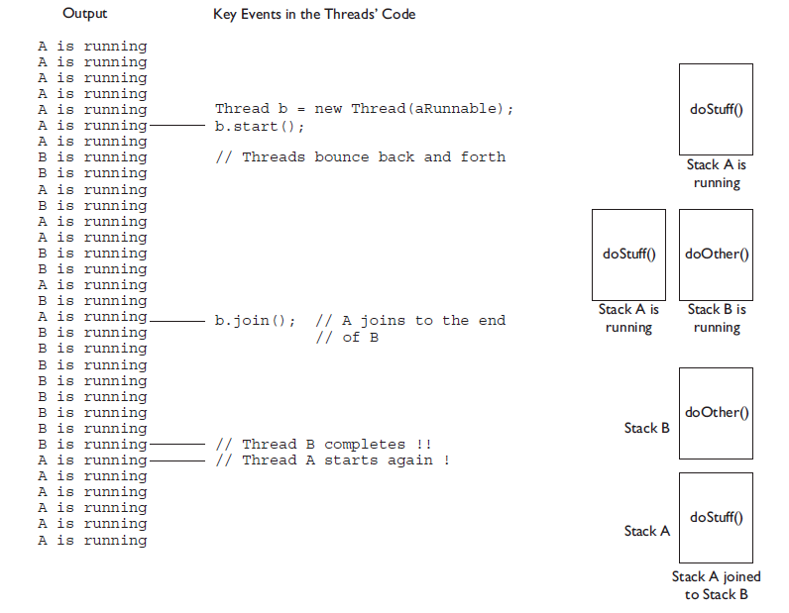
JOIN METHOD…

Slide 186
So far we've looked at three ways a running thread could leave the running state:
■ A call to sleep() Guaranteed to cause the current thread to stop executing for at least the specified sleep duration (although it might be interrupted before its specified time).
■ A call to yield() Not guaranteed to do much of anything, although typically it will cause the currently running thread to move back to runnable so that a thread of the same priority can have a chance.
■ A call to join() Guaranteed to cause the current thread to stop executing until the thread it joins with (in other words, the thread it calls join()

Slide 187
Besides those three, we also have the following scenarios in which a thread might leave the running state:
The thread's run() method completes.
The thread scheduler can decide to move the current thread from running to runnable in order to give another thread a chance to run. No reason is needed—the thread scheduler can trade threads in and out whenever it likes.

Slide 188
Scheduling
Thread scheduling is the mechanism used to determine how runnable threads are allocated CPU time..
A thread-scheduling mechanism is either preemptive or nonpreemptive

Slide 189
The scheduler in most JVMs uses preemptive, priority-based scheduling (which implies some sort of time slicing). This does not mean that all JVMs use time slicing.
The JVM specification does not require a VM to implement a time-slicing scheduler, where each thread is allocated a fair amount of time and then sent back to runnable to give another thread a chance.
Although many JVMs do use time slicing, some may use a scheduler that lets one thread stay running until the thread completes its run() method.

Slide 190
Don't rely on thread priorities when designing multithreaded application.
Because thread-scheduling priority behavior is not guaranteed..
use thread priorities as a way to improve the efficiency of program, but just be sure program doesn't depend on that behavior for correctness.

Slide 191
Thread Priority (cont.)
The priority can be adjusted subsequently using the setPriority() method
The priority of a thread may be obtained using getPriority()
Priority constants are defined:
MIN_PRIORITY=1
MAX_PRIORITY=10
NORM_PRIORITY=5
The main thread is
created with priority
NORM_PRIORITY

Slide 192
Synchronization
Why Synchronization?
“Race condition” is when two threads concurrently access the same object. This can produce corrupted data if one thread "races in" too quickly before an operation that should be "atomic" has completed.
Through synchronization we can guarantee that if a thread is running, no other running thread will be able to act on the same data.
We do this with the “synchronized” keyword.
void synchronized function( ){
//do stuff;
}

Slide 193
Java Collections

Slide 194
Java Collections Framework
The Java language API provides many of the data structures from this class for us..
The Collections Framework in Java, which took shape with the release of JDK 1.2 and was expanded in 1.4 and again in Java 5, and yet again in Java 6, gives lists, sets, maps, and queues to satisfy most of the coding needs.,
Pick the best one for your job and you'll get—at the least—reasonable performance.

Slide 195
So What Do You Do with a Collection?
Add objects to the collection.
Remove objects from the collection.
Find out if an object (or group of objects) is in the collection.
Retrieve an object from the collection (without removing it).
Iterate through the collection, looking at each element (object) one after another.

Slide 196
there are really three overloaded uses of the word "collection”
collection (lowercase c), which represents any of the data structures in which objects are stored and iterated over.
Collection (capital C), which is actually the java.util.Collection interface from which Set, List, and Queue extend. (That's right, extend, not implement.
Collections (capital C and ends with s) is the java.util.Collections class that holds a pile of static utility methods for use with collections.

Slide 197
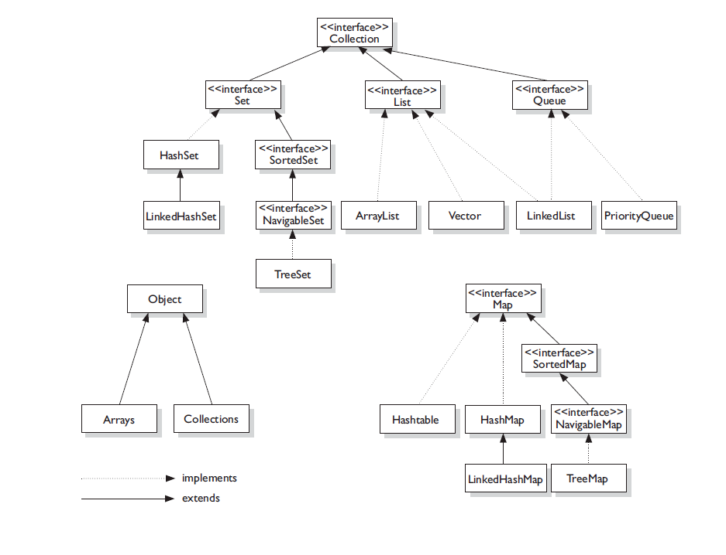
Collection

Slide 198
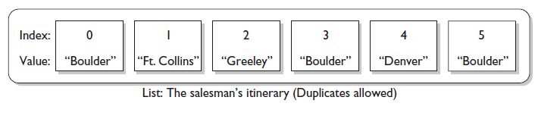
List
The structure of a List,

Slide 199
List
the list interface offers
Positional access
Search
Customized Iteration
List Implementation
ArrayList offers better performance compared to Linkedlist.
List
Arraylist
Vector
Linkedlist

Slide 200
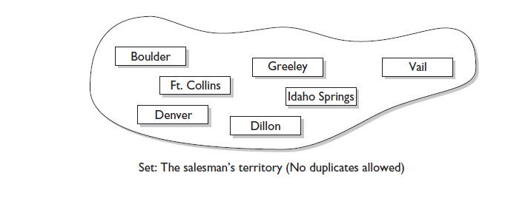
SET

Slide 201
Set
Set Interface: It offers inherited services from the root Collection interface with the added functionality of restricting duplicate elements.
Implementations:
Set
HashSet
TreeSet
LinkedHashSet

Slide 202
MAP
Map — an object that maps keys to values. A Map cannot contain duplicate keys; each key can map to at most one value.

Slide 203
Map Implementations
Map
HashMap
TreeMap
Linkedlist
HashTable

Slide 204
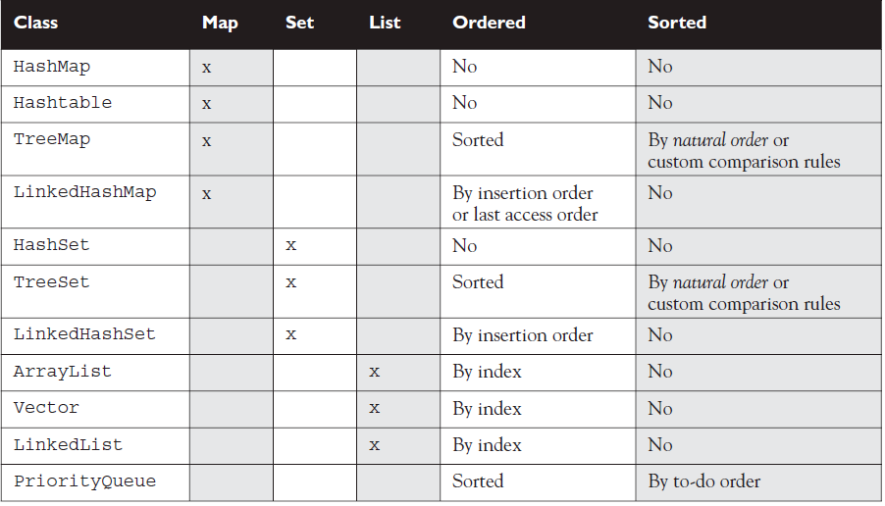
QUICK OVERVIEW

Slide 205
A note on Iterator
An Iterator is an object that enables to traverse through a collection and to remove elements from the collection selectively, if desired. You get an Iterator for a collection by calling its iterator() method. The following is the Iterator interface.
public interface Iterator<E> {
boolean hasNext();
E next();
void remove(); //optional
}

Slide 206
Iterate Through Collections
The Itertor interface:
interface Iterator {
boolean hasNext();
Object next();
void remove();
}
The iterator() method defined in the Collection interface:
Iterator iterator()

Slide 207
boolean hasNext() Returns true if there is at least one more element in the collection being traversed. Invoking hasNext() does NOT move you to the next element of the collection.
■ Object next() This method returns the next object in the collection,AND moves you forward to the element after the element just returned.

Slide 208
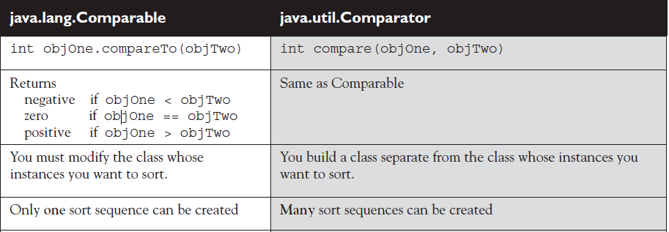
Comparing Comparable to Comparator Interface..

Slide 209
Introduction to Swing

Slide 210
About JFC and Swing
JFC – JavaTM Foundation Classes
Encompass a group of features for constructing graphical user interfaces (GUI).
Implemented without any native code.
“Swing” is the codename of the project that developed the first JFC components (JFC 1.1¹).

Slide 211
About JFC and Swing (cont)
Swing features:
Light weight component..
Pluggable Look and Feel
Accessibility API
Screen readers, Braille displays, ...

Slide 212



Pluggable Look and Feel
Each picture shows the same program but with a different look and feel

Slide 213
Swing is a set of customizable graphical components whose look-and-feel (L&F) can be dictated at runtime.
Swing Features :
Pluggable Look-and-Feel
Lightweight Components .
java.lang.Object
java.awt.Component
java.awt.Container
javax.swing.JComponent

Slide 214
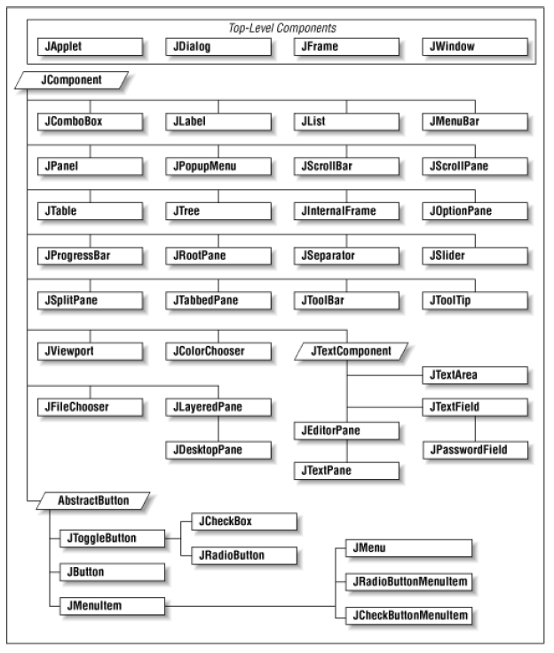
Swing Class Hierarchy

Slide 215
Containers
Provides support to Swing components for their painting and event-handling.
Swing provides five top-level containers:
JFrame (Main window)
JDialog (Secondary window)
JApplet (An applet display area)
JWindow
JInternalFrame (light weight frames that exist inside another container)
Each container has a content pane that contains visible components.

Slide 216
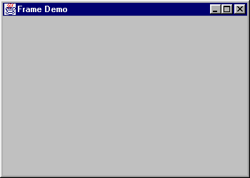
JFrame
A JFrame is an independent window that can be moved around on the screen
independent of any other GUI windows.
1. import javax.swing.*;
2.
3. public class FrameDemo {
4. public static void main(String[] args) {
5. JFrame f = new JFrame("Frame Demo");
6. f.setSize(350, 250);
7. f.setVisible(true);
8. }
9. }

Slide 217
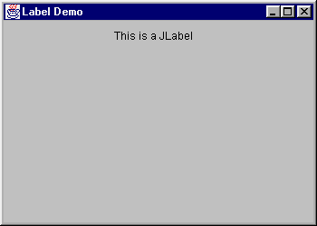
JLabel
The simplest component type is the JLabel, which displays a single-line text string and/or an image.

Slide 218
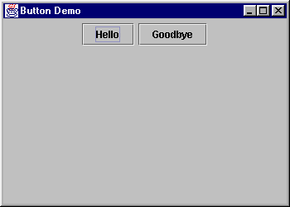
JButton
The JButton class implements a simple pushbutton. The button can display
a text label, an icon, or both. When the user “pushes” the button, Action
events are sent to all registered Action listeners.

Slide 219
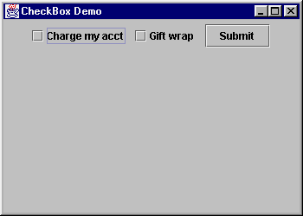
JCheckBox
The JCheckBox class implements a check box that can be selected and deselected.

Slide 220
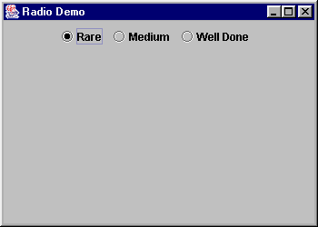
JRadioButton
Radio buttons are typically used in groups, to present exclusive selection.

Slide 221
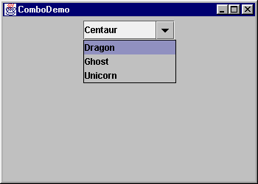
JComboBox
The JComboBox component combines the functionality of a text field and a drop-down list.

Slide 222
Layouts
Determines the size and position of the components within a container .
Commonly used layout managers:
BoxLayout
BorderLayout
FlowLayout
GridLayout
GridBagLayout

Slide 223
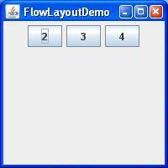
FlowLayout
lays out components in a single row, starting a new row if its container is not sufficiently wide. It is the default manager type for panels and applets
The possible values are
FlowLayout.LEFT,
FlowLayout.CENTER
FlowLayout.RIGHT.

Slide 224
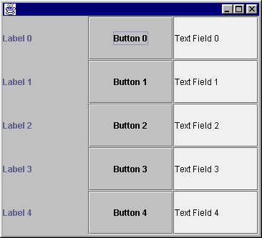
The Grid Layout Manager
displays components in the requested number of rows and columns.
public GridLayout(int nRows, int nColumns)

Slide 225
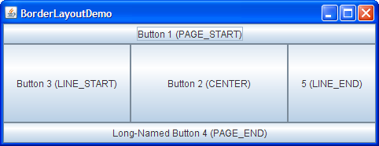
The Border Layout Manager
Places components in up to five areas: top, bottom, left, right, and center.
The five constants are:
BorderLayout.NORTH
BorderLayout.SOUTH
BorderLayout.EAST
BorderLayout.WEST
BorderLayout.CENTER

Slide 226
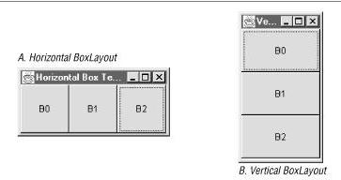
Box Layout
Aligns components along the horizontal or vertical axis.

Slide 227
Java2D
Provides -
A wide range of geometric primitives.
Enhances the graphics, text, and imaging capabilities.
A compositing model that provides control over how overlapping objects are rendered.
Support for printing complex documents.

Slide 228

Geometric Primitives
Java 2D API provides a set of standard shapes such as:
Points: defines a point representing a location in (x, y) coordinate space.
Lines: represents a line that can be drawn using two points. (x1,y1) (x2,y2)
Rectangular Shapes: The Rectangle2D, RoundRectangle2D, Arc2D, and Ellipse2D primitives are all derived from the RectangularShape class.

Slide 229
General Path
We can define all the line segments to create a brand-new Shape.
Methods:
moveTo(float x, float y) – Moves the current point of the path to the given point
lineTo(float x, float y) – Adds a line segment to the current path
quadTo(float x1, float y1, float x2, floaty2) – Adds a quadratic curve segment to the current path
curveTo(float x1, float y1, float x2, float y2, float x3, floaty3) – Adds a cubic curve segment to the current path
closePath() – Closes the current path

Slide 230

Example: GeneralPath
GeneralPath path = new GeneralPath( );
path.moveTo(50,50);
path.lineTo(250,150);
path.quadTo(150,200,240,200);
path.lineTo(240,350);
path.curveTo(150,200,100,150,190,190);
path.closePath( );
graphics2D.draw(path);

Slide 231
2D Transformation
Transformations:
rotate--to specify an angle of rotation in radians
scale--to specify a scaling factor in the x and y directions
shear--to specify a shearing factor in the x and y directions
translate--to specify a translation offset in the x and y directions

Slide 232
Translation :
Translate individual
vertices
Rotation:
Rotate individual
Vertices
θ

Slide 233
Scaling :
.
Scale individual
Vertices
Shearing :
Shearing in X-direction
Shearing in Y-direction

Slide 234
junit

Slide 235
An open-source regression testing framework for unit-testing Java programs..
It is a test driven development framework which helps performing unit tests for a software system.
WHY JUNIT TESTING IS IMPORTANT—
Like every other unit test frameworks, JUnit helps to find out bugs in a Java code snippet or any other indivisible software component.
JUnit ensures that every logical component of the system is working with optimal performance. Thus it focuses only on individual modules and doesn’t pay any attention to the connections between these entities.

Slide 236
Without using JUnit the programmer will have to use the “println()” function to output faults on the console.
With JUnit this is mostly automated.
JUnit aggregates the results of the tests performed in a well structured manner.
HOW JUNIT TESTING IS PERFORMED—
JUnit suggest test driven software development.
In test driven development, the programmer first designs test cases and later on writes the code for the required business process.
When the test case is first run, it shows high number of faults.
The programmer tries to eliminate these errors one after the other until the code is bug free.
Once this is done, the programmer tunes up the code in terms of quality and design. Same approach is used to develop the entire software

Slide 237
Advantages of Testing with JUnit:
Quick and easy generation of test cases and test data.
Ability to reuse the older test cases as well as the test data for making a new test case.
Promote TDD, i.e. Test Driven Development Enhance productivity and reduce production cost.
Excellent and highly comprehensive reporting technique.
Easy contrast between expected output and the output displayed on the console.
Logical aggregation of test cases.

Slide 238
product Detail

Slide 239
CoreLog
The Well Logging Software
Salient features

Slide 240
Introduction
Well logging is a technique used in the oil and gas industry for recording rock and fluid properties to find hydrocarbon zones in the geological formations within the earth's crust. Our software provides an easy way to analyze, visualize and calculate well log data.

Slide 241
Main Modules
Well log import
- LAS file import.
- GSLIB file import.
- Core data import.
- Galaxy well data import.
- Marker Data
-Daviation Survey Data
- Core Image Data
- Well Head Data
Well log export
- LAS data export.
- GSLIB data export.
- Marker Data Export

Slide 242
Main Modules (contd.)
Comprehensive display modules
- Base Map.
- Log Plots.
- Cross Plots.
- Histogram.

Slide 243
LAS File Import
CoreLog supports following versions of LAS format.
LAS 1.2
LAS 2.0
Multiple files (batch) import is also supported.

Slide 244
GSLIB File Import
Currently CoreLog supports following GSLIB extension files.
.xls
.dat
.gslib
Without extension.
Multiple files (batch) import is also supported.

Slide 245
Core Data Import
Currently supports following core data extension files.
.xls.
Multiple files (batch) import is also supported.
Galaxy Well Data Import
Can import well log data from a Galaxy project.
Multiple files (batch) import is also supported.

Slide 246
LAS Data Export
Currently CoreLog can export log data in the following versions of LAS format.
LAS 1.2
LAS 2.0
Can export multiple data sets in one go.
GSLIB Data Export
Can export log data in the GSLIB format.
Can export multiple data sets in one go.

Slide 247
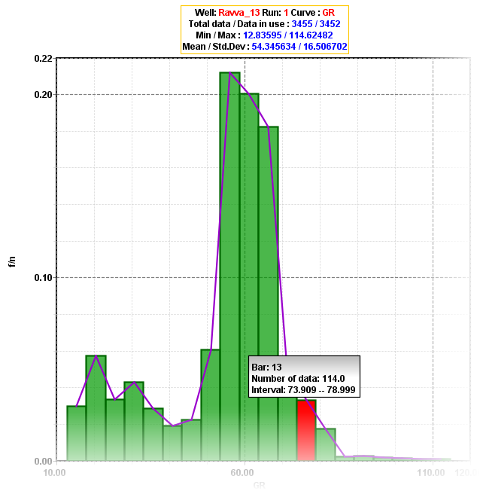
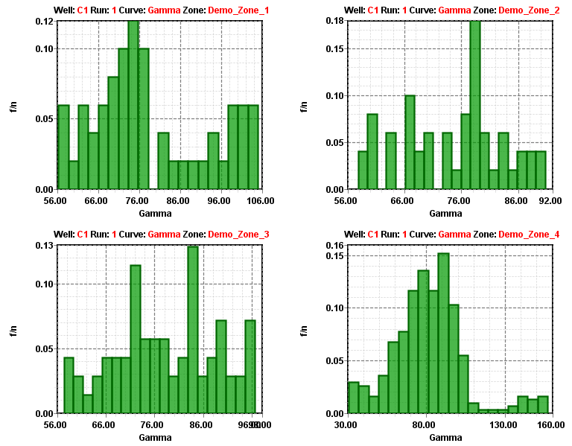
Display: Histogram
Histogram depicts the frequency distribution of any data. Histograms can be plotted for Single Zone as well as for Multiple Zones.
Single zone view: Multi zone view:

Slide 248
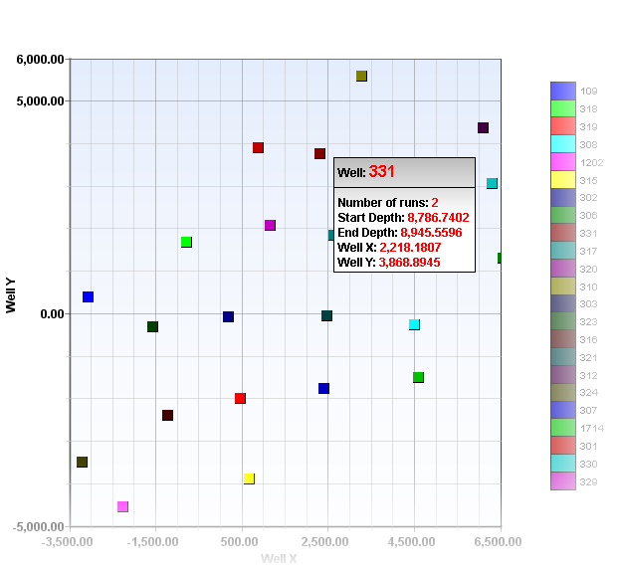
Display: Basemap
Multiple well’s position of the selected region can be seen on the Basemap.

Slide 249
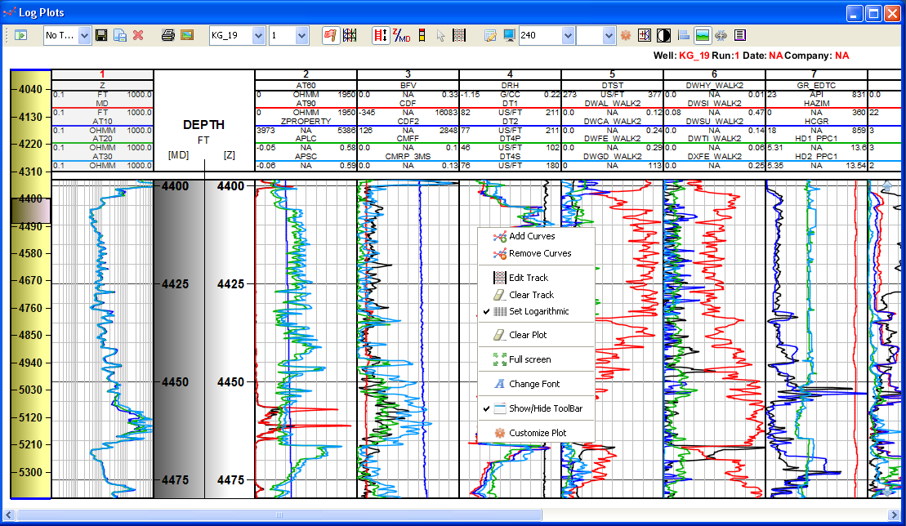
Display: LogPlot
The log plot module can be used to view well log curves more than one at a time and on more than one tracks.

Slide 250
Thank You

